Slide 1
Paper 2
學生:林奇鋒

Slide 2

Data Preprocess

Slide 3
Data Processing
Experimentation2_2002
 | Training | Testing
TAIEX | 01/01/2002~9/30/2002 | 10/01/2002~12/31/2002
DJIA | 01/07/2002~9/30/2002 | 10/01/2002~01/03/2003
NASDAQ | 01/07/2002~9/30/2002 | 10/01/2002~01/03/2003
S&P500 | 01/07/2002~9/30/2002 | 10/01/2002~01/03/2003
184
64

Slide 4

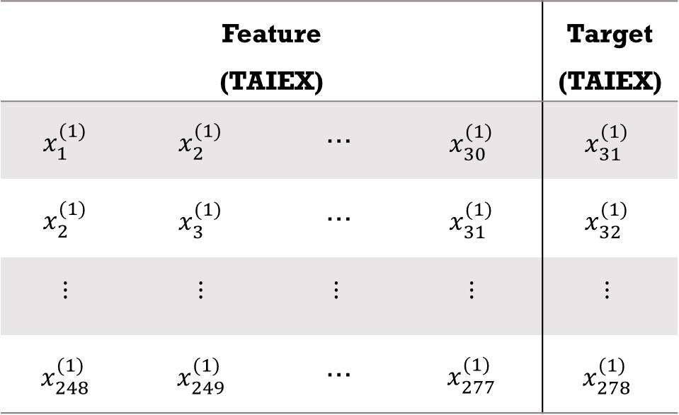


Data Processing
$1^{st}$difference
$d_{i+1}^{(1)}−d_{i}^{(1)}=x_{i}^{(1)},i=1,2,…,2$48
Number Of Data: 279
Feature (TAIEX) |  |  |  | Target (TAIEX)
$$x_{1}^{(1)}$$ | $$x_{2}^{(1)}$$ | … | $$x_{30}^{(1)}$$ | $$x_{31}^{(1)}$$
$$x_{2}^{(1)}$$ | $$x_{3}^{(1)}$$ | … | $$x_{31}^{(1)}$$ | $$x_{32}^{(1)}$$
$$⋮$$ | $$⋮$$ | $$⋮$$ | $$⋮$$ | $$⋮$$
$$x_{248}^{(1)}$$ | $$x_{249}^{(1)}$$ | … | $$x_{277}^{(1)}$$ | $$x_{278}^{(1)}$$
$1^{st}$difference
Number Of Data: 278
Number Of Feature:30

Slide 5
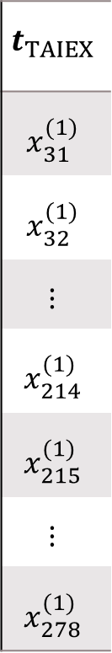
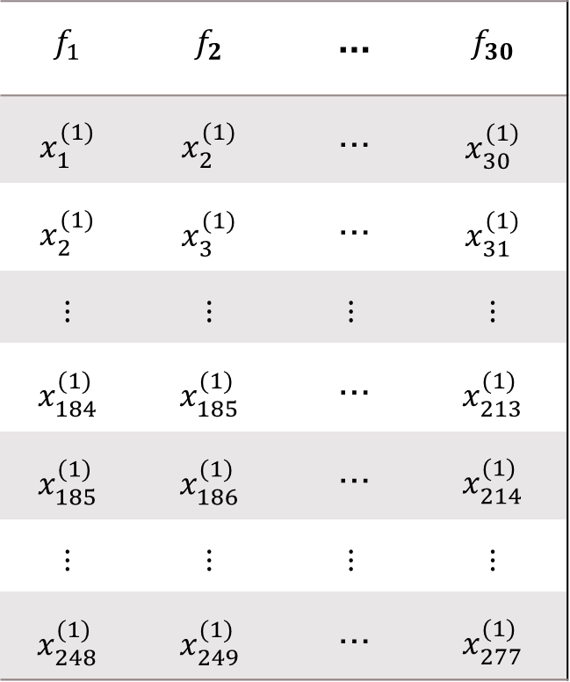
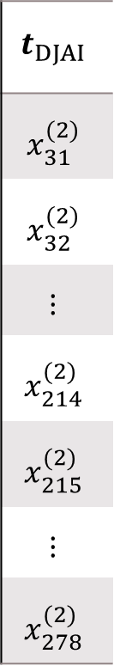
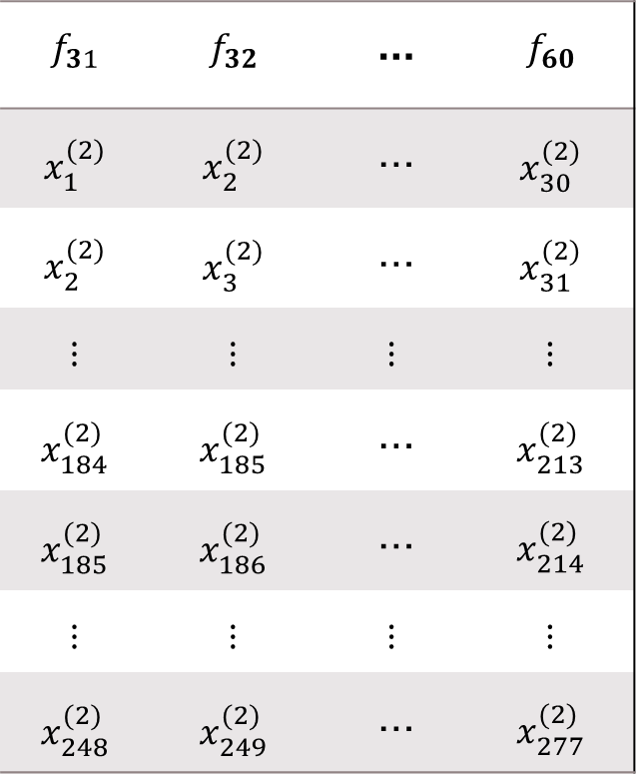
Data Processing
$$f_{1}$$ | $$f_{2}$$ | … | $$f_{30}$$
$$x_{1}^{(1)}$$ | $$x_{2}^{(1)}$$ | … | $$x_{30}^{(1)}$$
$$x_{2}^{(1)}$$ | $$x_{3}^{(1)}$$ | … | $$x_{31}^{(1)}$$
$$⋮$$ | $$⋮$$ | $$⋮$$ | $$⋮$$
$$x_{184}^{(1)}$$ | $$x_{185}^{(1)}$$ | … | $$x_{213}^{(1)}$$
$$x_{185}^{(1)}$$ | $$x_{186}^{(1)}$$ | … | $$x_{214}^{(1)}$$
$$⋮$$ | $$⋮$$ | $$⋮$$ | $$⋮$$
$$x_{248}^{(1)}$$ | $$x_{249}^{(1)}$$ | … | $$x_{277}^{(1)}$$
$$f_{31}$$ | $$f_{32}$$ | … | $$f_{60}$$
$$x_{1}^{(2)}$$ | $$x_{2}^{(2)}$$ | … | $$x_{30}^{(2)}$$
$$x_{2}^{(2)}$$ | $$x_{3}^{(2)}$$ | … | $$x_{31}^{(2)}$$
$$⋮$$ | $$⋮$$ | $$⋮$$ | $$⋮$$
$$x_{184}^{(2)}$$ | $$x_{185}^{(2)}$$ | … | $$x_{213}^{(2)}$$
$$x_{185}^{(2)}$$ | $$x_{186}^{(2)}$$ | … | $$x_{214}^{(2)}$$
$$⋮$$ | $$⋮$$ | $$⋮$$ | $$⋮$$
$$x_{248}^{(2)}$$ | $$x_{249}^{(2)}$$ | … | $$x_{277}^{(2)}$$
$$t_{TAIEX}$$
$$x_{31}^{(1)}$$
$$x_{32}^{(1)}$$
$$⋮$$
$$x_{214}^{(1)}$$
$$x_{215}^{(1)}$$
$$⋮$$
$$x_{278}^{(1)}$$
$$t_{DJAI}$$
$$x_{31}^{(2)}$$
$$x_{32}^{(2)}$$
$$⋮$$
$$x_{214}^{(2)}$$
$$x_{215}^{(2)}$$
$$⋮$$
$$x_{278}^{(2)}$$
Training
(184)
…
…
Testing
(64)
Sequence: TAIEX, DJIA, NASDAQ, S&P500

Slide 6


Entropy
$$H(x)=\int{p_{d}\left(x\right)log⁡(\frac{1}{p_{d}\left(x\right)})dx}$$
If$p_{d}\left(x\right)>$1，log part is negative，so we have to change formula:
$$H(x)=\int{p_{d}\left(x\right)log⁡(\frac{φ_{1}}{p_{d}\left(x\right)})dx}$$
$$φ_{1}=max(1,ε+max\left(p_{d}\left(x\right)\right))$$
,where $ε={1×10}^{−10}$
Notes:
max($p_{d}$(x))=getPdf(x)
Function getPdf(data)
pd=fitdist(data,'kernel');
domain=linspace(pd.mean-5*pd.std,pd.mean+5*pd.std,500);
output=pdf(pd, domain);

Slide 7
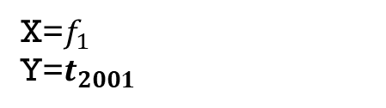
Pdf(IBM)
X=$f_{1}$
Y=$t_{2001}$
Notes:
Xarea=0.9996
Yarea=0.9972
YX+area=0.9999
YX-area=0.9999
Y較高，但是Y|X+和Y|X-變低，也就是機率變平均，entropy(混亂程度變高)，可以解釋成特徵1對Y造成負面影響

Slide 8
pdf
X=$f_{1}$
Y=$t_{2001}$
Notes:
Xarea=0.9996
Yarea=0.9999
YX+area=0.9999
YX-area=0.9999
Y較高，但是Y|X+和Y|X-變低，也就是機率變平均，entropy(混亂程度變高)，可以解釋成特徵1對Y造成負面影響

Slide 9
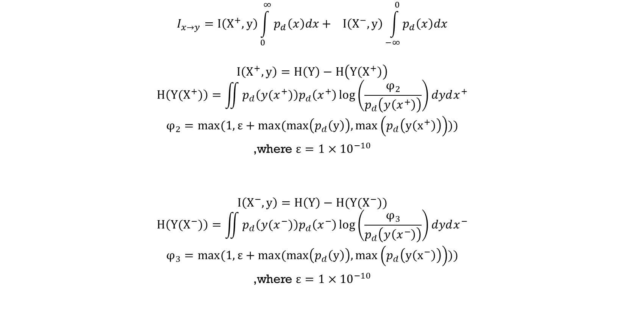
Influence Information:
$$I_{x→y}=I\left(X^{+},y\right)\int_{0}^{∞}{p_{d}\left(x\right)dx}+ I\left(X^{−},y\right)\int_{−∞}^{0}{p_{d}\left(x\right)dx}$$
$$I\left(X^{+},y\right)=H\left(Y\right)−H\left(Y\left(X^{+}\right)\right)$$
$$H\left(Y(X^{+})\right)=\iint{p_{d}\left(y(x^{+})\right)p_{d}\left(x^{+}\right)\log\left(\frac{φ_{2}}{p_{d}\left(y\left(x^{+}\right)\right)}\right)dydx^{+}}$$
$$φ_{2}=max(1,ε+max(max\left(p_{d}\left(y\right)\right),max\left(p_{d}\left(y\left(x^{+}\right)\right)\right)))$$
,where $ε={1×10}^{−10}$
$$I\left(X^{−},y\right)=H\left(Y\right)−H(Y(X^{−}))$$
$$H\left(Y(X^{−})\right)=\iint{p_{d}\left(y(x^{−})\right)p_{d}\left(x^{−}\right)\log\left(\frac{φ_{3}}{p_{d}\left(y\left(x^{−}\right)\right)}\right)dydx^{−}}$$
$$φ_{3}=max(1,ε+max(max\left(p_{d}\left(y\right)\right),max\left(p_{d}\left(y\left(x^{−}\right)\right)\right)))$$
,where $ε={1×10}^{−10}$

Slide 10
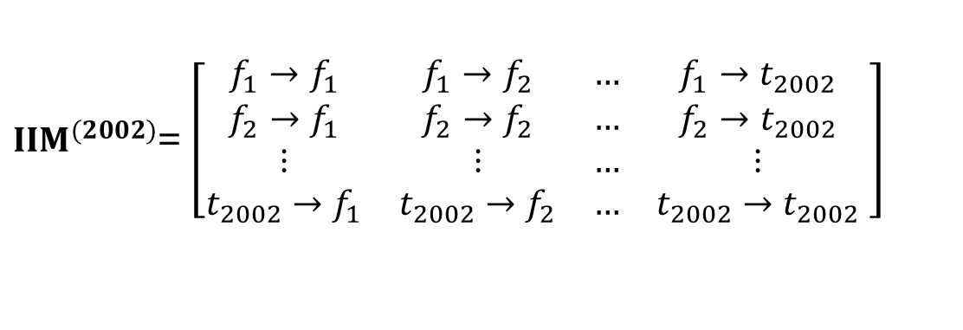
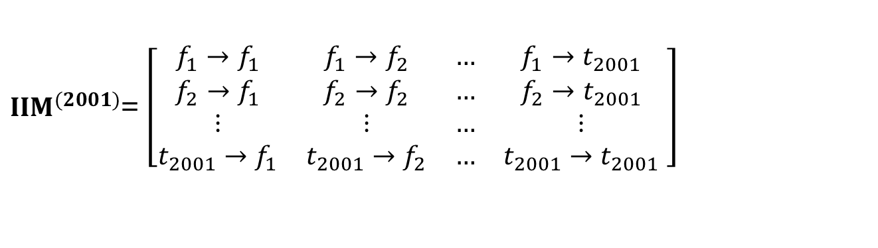

Influence Information Matrix
target
$IIM^{(2001)}$= $\left[\begin{matrix}f_{1}→f_{1} & f_{1}→f_{2} & … & f_{1}→t_{2001} \\ f_{2}→f_{1} & f_{2}→f_{2} & … & f_{2}→t_{2001} \\ ⋮ & ⋮ & … & ⋮ \\ t_{2001}→f_{1} & t_{2001}→f_{2} & … & t_{2001}→t_{2001}\end{matrix} \right]$
target
$IIM^{(2002)}$= $\left[\begin{matrix}f_{1}→f_{1} & f_{1}→f_{2} & … & f_{1}→t_{2002} \\ f_{2}→f_{1} & f_{2}→f_{2} & … & f_{2}→t_{2002} \\ ⋮ & ⋮ & … & ⋮ \\ t_{2002}→f_{1} & t_{2002}→f_{2} & … & t_{2002}→t_{2002}\end{matrix} \right]$
$$⋮$$

Slide 11
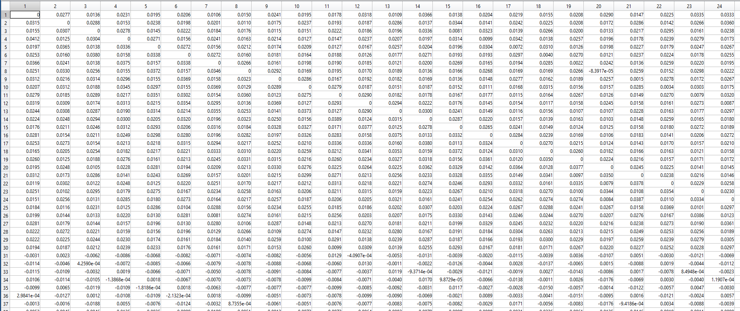
Influence Information Matrix(2001y)

Slide 12
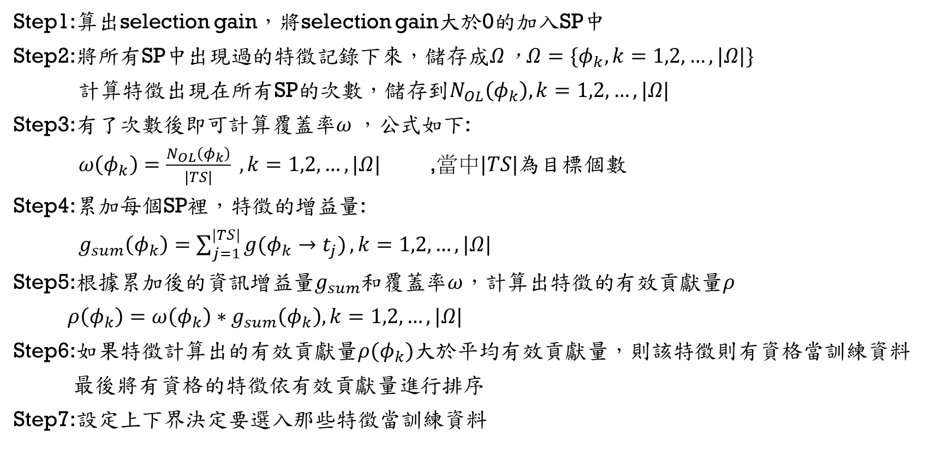
Multi-Target Feature selection
Step1:算出selection gain，將selection gain大於0的加入SP中
Step2:將所有SP中出現過的特徵記錄下來，儲存成$Ω$，$Ω=\{φ_{k},k=1,2,…,|Ω|\}$
計算特徵出現在所有SP的次數，儲存到$N_{OL}\left(φ_{k}\right),k=1,2,…,|Ω|$
Step3:有了次數後即可計算覆蓋率$ω$，公式如下:
$ω\left(φ_{k}\right)=\frac{N_{OL}\left(φ_{k}\right)}{|TS|} ,k=1,2,…,|Ω|$ ,當中$|TS|$為目標個數
Step4:累加每個SP裡，特徵的增益量:
$g_{sum}\left(φ_{k}\right)=\sum_{j=1}^{|TS|}{g(φ_{k}→t_{j})},k=1,2,…,|Ω|$
Step5:根據累加後的資訊增益量$g_{sum}$和覆蓋率$ω$，計算出特徵的有效貢獻量$ρ$
$ρ\left(φ_{k}\right)=ω\left(φ_{k}\right)∗g_{sum}\left(φ_{k}\right),k=1,2,…,|Ω|$
Step6:如果特徵計算出的有效貢獻量$ρ(φ_{k})$大於平均有效貢獻量，則該特徵則有資格當訓練資料
最後將有資格的特徵依有效貢獻量進行排序
Step7:設定上下界決定要選入那些特徵當訓練資料

Slide 13
Step1:
算出selection gain

Slide 14
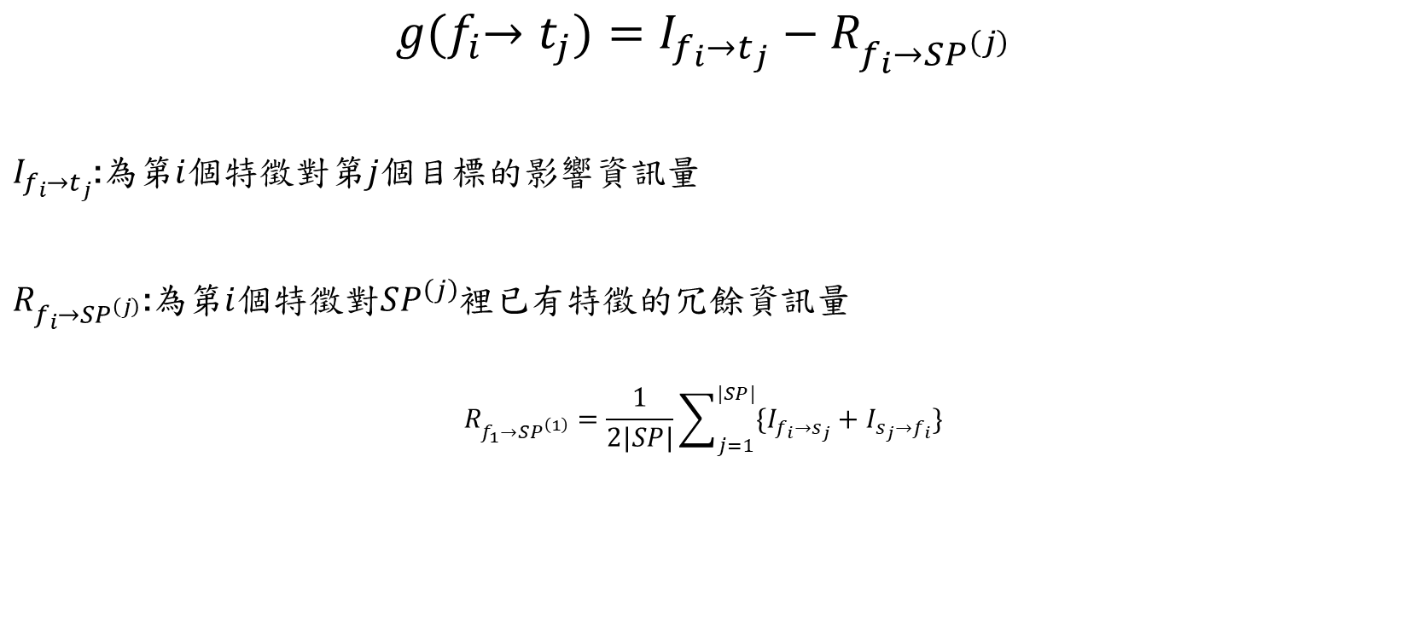
Multi-Target Feature selection
Step1
$$g{(f}_{i}→t_{j})=I_{f_{i}→t_{j}}−R_{f_{i}→SP^{\left(j\right)}}$$
$I_{f_{i}→t_{j}}$:為第$i$個特徵對第$j$個目標的影響資訊量
$R_{f_{i}→SP^{\left(j\right)}}$:為第$i$個特徵對$SP^{\left(j\right)}$裡已有特徵的冗餘資訊量
$$R_{f_{1}→SP^{\left(1\right)}}=\frac{1}{2|SP|}\sum_{j=1}^{|SP|}{\{I_{f_{i}→s_{j}}+I_{s_{j}→f_{i}}\}}$$

Slide 15









Multi-Target Feature Selection(Example)
Step1
$$g{(f}_{1}→t_{1})=I_{f_{1}→t_{1}}−R_{f_{1}→SP^{\left(1\right)}}$$
$$g{(f}_{2}→t_{1})=I_{f_{2}→t_{1}}−R_{f_{2}→SP^{\left(1\right)}}$$
$SP^{\left(1\right)}=${$f_{49}$ }
$SP^{\left(1\right)}=${$f_{49}$ $f_{1}$}
$$R_{f_{1}→SP^{\left(1\right)}}=(I_{f_{1}→f_{49}}+I_{f_{49}→f_{1}})/2$$
$$R_{f_{2}→SP^{\left(1\right)}}=(I_{f_{2}→f_{1}}+I_{f_{1}→f_{2}}+I_{f_{2}→f_{49}}+I_{f_{49}→f_{2}})/4$$
$$g{(f}_{1}→t_{1})>0$$
$$g{(f}_{2}→t_{1})<0$$
$SP^{\left(1\right)}=${$f_{49}$ $f_{1}$}
$SP^{\left(1\right)}=${$f_{49}$ $f_{1}$}

Slide 16




Step1
$$SP^{\left(1\right)}$$
90
$$SP^{\left(2\right)}$$
91
$$SP^{\left(3\right)}$$
91
$$SP^{\left(4\right)}$$
91

Slide 17
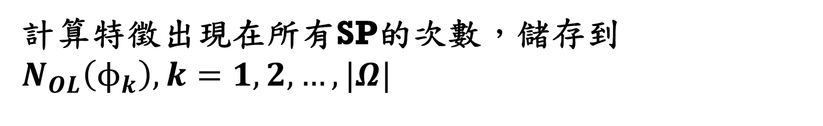
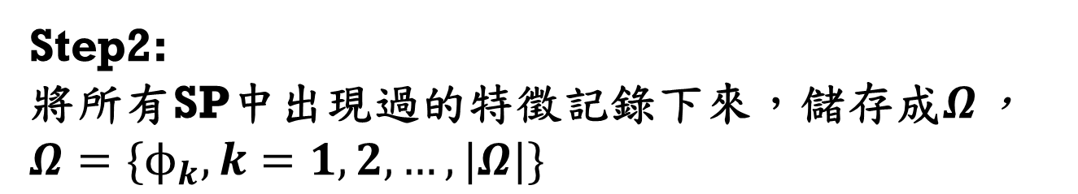
Step2:
將所有SP中出現過的特徵記錄下來，儲存成$Ω$，$Ω=\{ϕ_{k},k=1,2,…,|Ω|\}$
計算特徵出現在所有SP的次數，儲存到$N_{OL}\left(ϕ_{k}\right),k=1,2,…,|Ω|$

Slide 18


Step2
$$SP^{\left(1\right)}$$
90
$$Ω$$
93
$$SP^{\left(2\right)}$$
91
$$N_{OL}$$
$$SP^{\left(3\right)}$$
91
$$SP^{\left(4\right)}$$
91

Slide 19
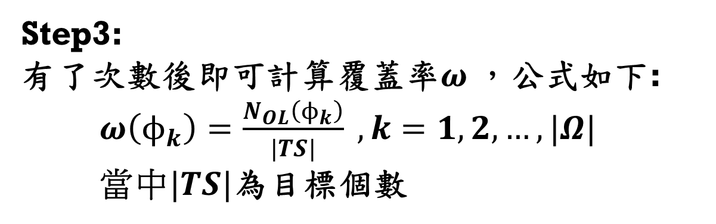
Step3:
有了次數後即可計算覆蓋率$ω$，公式如下:
$ω\left(ϕ_{k}\right)=\frac{N_{OL}\left(ϕ_{k}\right)}{|TS|} ,k=1,2,…,|Ω|$
當中$|TS|$為目標個數

Slide 20




Step3
計算$Ω$中，出現在每個SP的累積次數
透過累積次數計算覆蓋率
$$Ω$$
$$N_{OL}$$
$$ω$$

Slide 21
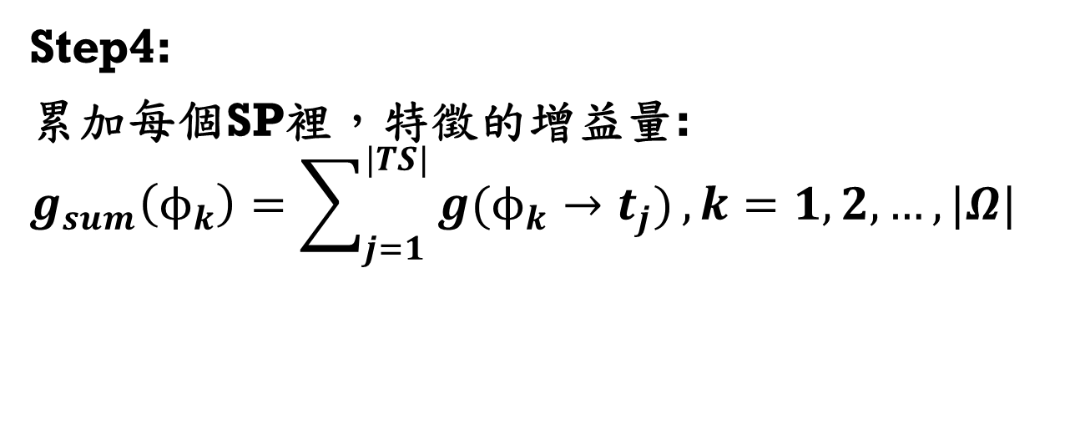
Step4:
累加每個SP裡，特徵的增益量:
$$g_{sum}\left(ϕ_{k}\right)=\sum_{j=1}^{|TS|}{g(ϕ_{k}→t_{j})},k=1,2,…,|Ω|$$

Slide 22








Step4
$$g{(f}_{i}→t_{1})$$
將$Ω$中，每個特徵的selection gain累加
$$g{(f}_{i}→t_{2})$$
把每個特徵累加的值給$g_{sum}$
$$Ω$$
$$g_{sum}$$
$$g{(f}_{i}→t_{3})$$
$$g{(f}_{i}→t_{4})$$

Slide 23
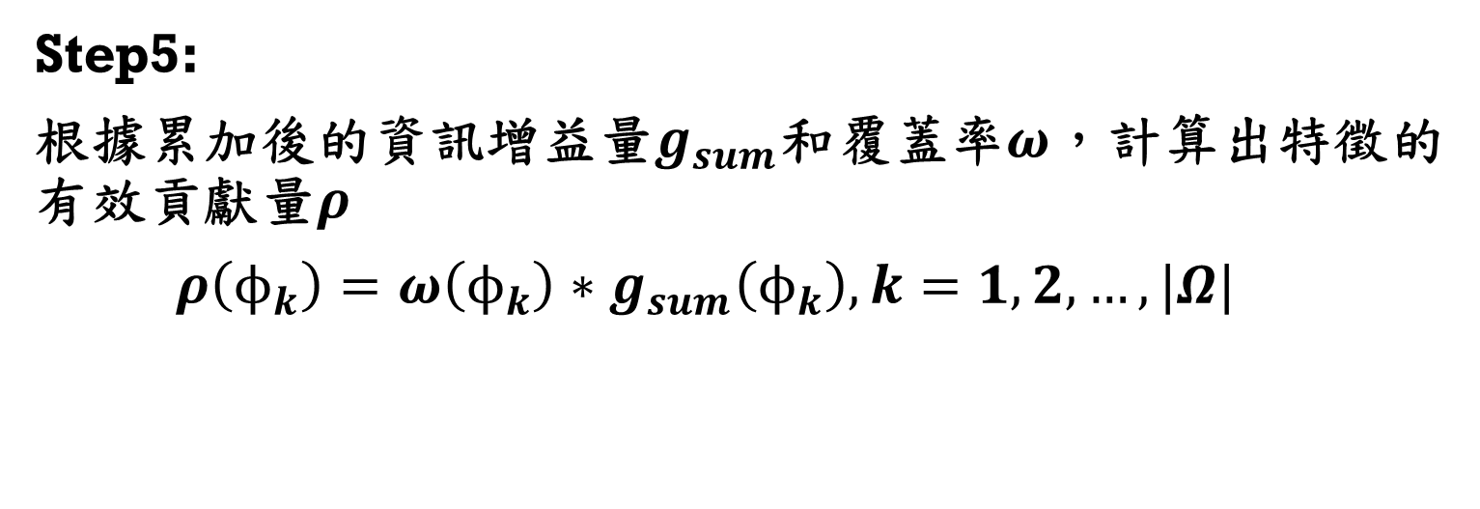
Step5:
根據累加後的資訊增益量$g_{sum}$和覆蓋率$ω$，計算出特徵的有效貢獻量$ρ$
$ρ\left(ϕ_{k}\right)=ω\left(ϕ_{k}\right)∗g_{sum}\left(ϕ_{k}\right),k=1,2,…,|Ω|$

Slide 24







Step5
將$Ω$中每個特徵的覆蓋率，從$ω$中取出
$$ω$$
將$ω$和$g_{sum}相乘$得到有效貢獻率$ρ$
$$Ω$$
$$ρ$$
將$Ω$中每個特徵的貢獻率，從$g_{sum}$中取出
$$g_{sum}$$

Slide 25
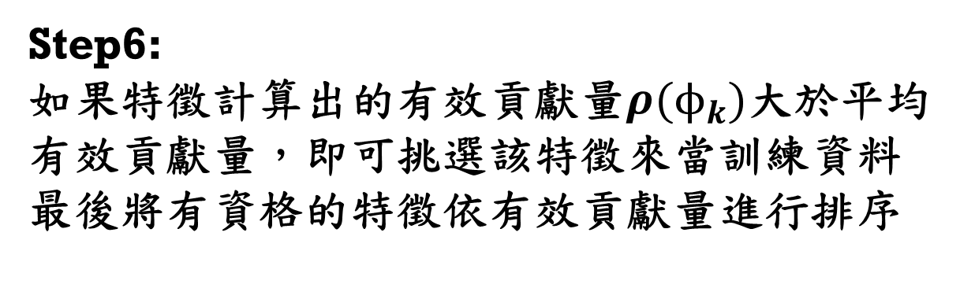
Step6:
如果特徵計算出的有效貢獻量$ρ(ϕ_{k})$大於平均有效貢獻量，即可挑選該特徵來當訓練資料
最後將有資格的特徵依有效貢獻量進行排序

Slide 26





Step6
門檻(Threshold)=$\overline{ω}∗{\overline{g}}_{sum}=$0.9758*2.5521=2.4904
查看$ρ$是否有大於門檻值，有大於則列入有資格區
將$Ω$中每個特徵的有效貢獻率，從$ρ$中取出
$$Ω$$
$$ρ$$
$$Qualified$$

Slide 27
Step7:
設定上下界決定要選入那些特徵當訓練資料

Slide 28




Step7
上界:4
下界:2
將資格區的特徵貢獻率進行排序
透過上下界的篩選，得到要訓練的特徵索引
$$Qualified$$
$F$P

Slide 29







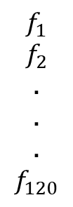



Multi-Target Feature Selection
CP
SP
FP
$$g{(f}_{i}→t_{1})>0$$
$$f_{117}$$
$$f_{52}$$
$$f_{92}$$
$$f_{51}$$
.
.
.
.
$$f_{1}$$
$$f_{2}$$
.
.
.
$$f_{120}$$
$$SP^{(1)}$$
$$g{(f}_{i}→t_{2})>0$$
$$SP^{(2)}$$
$$ρ\left(ϕ_{k}\right)>\overline{ω}∗\overline{g_{sum}}$$
$$g{(f}_{i}→t_{3})>0$$
$$SP^{(3)}$$
$$g{(f}_{i}→t_{4})>0$$
$$SP^{(4)}$$

Slide 30
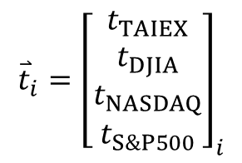
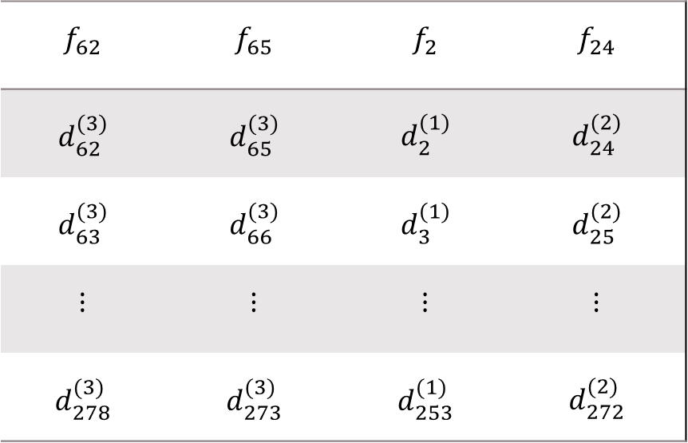

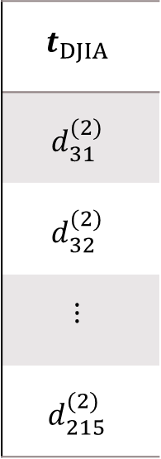

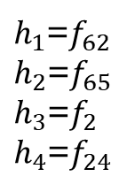
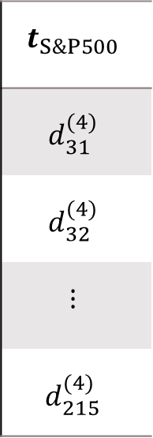
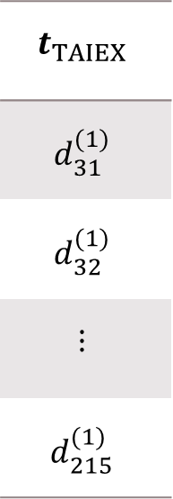
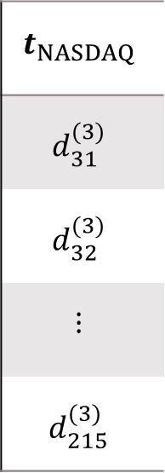
Data pair
$${\overset{⃑}{x}}_{i}={\left[\begin{matrix}h_{1} \\ h_{2} \\ h_{3} \\ h_{4}\end{matrix}\right]}_{i}$$
$h_{1}$=$f_{62}$
$h_{2}$=$f_{65}$
$h_{3}$=$f_{2}$
$h_{4}$=$f_{24}$
$${\overset{⃑}{t}}_{i}={\left[\begin{aligned}t_{TAIEX} \\ t_{DJIA} \\ \begin{aligned}t_{NASDAQ} \\ t_{S\&P500}\end{aligned}\end{aligned}\right]}_{i}$$
$$TD=\{\left({\overset{⃑}{x}}_{i},{\overset{⃑}{t}}_{i}\right),i=1,2,…,184\}$$
$$f_{62}$$ | $$f_{65}$$ | $$f_{2}$$ | $$f_{24}$$
$$d_{62}^{(3)}$$ | $$d_{65}^{(3)}$$ | $$d_{2}^{(1)}$$ | $$d_{24}^{(2)}$$
$$d_{63}^{(3)}$$ | $$d_{66}^{(3)}$$ | $$d_{3}^{(1)}$$ | $$d_{25}^{(2)}$$
$$⋮$$ | $$⋮$$ | $$⋮$$ | $$⋮$$
$$d_{278}^{(3)}$$ | $$d_{273}^{(3)}$$ | $$d_{253}^{(1)}$$ | $$d_{272}^{(2)}$$
$$t_{TAIEX}$$
$$d_{31}^{(1)}$$
$$d_{32}^{(1)}$$
$$⋮$$
$$d_{215}^{(1)}$$
$$t_{DJIA}$$
$$d_{31}^{(2)}$$
$$d_{32}^{(2)}$$
$$⋮$$
$$d_{215}^{(2)}$$
$$t_{NASDAQ}$$
$$d_{31}^{(3)}$$
$$d_{32}^{(3)}$$
$$⋮$$
$$d_{215}^{(3)}$$
$$t_{S\&P500}$$
$$d_{31}^{(4)}$$
$$d_{32}^{(4)}$$
$$⋮$$
$$d_{215}^{(4)}$$

Slide 31
MODEL CONSTRUCTION 1. Structure Learning 2. Model Structure and I/O Relationship 3. Parameter Learning

Slide 32
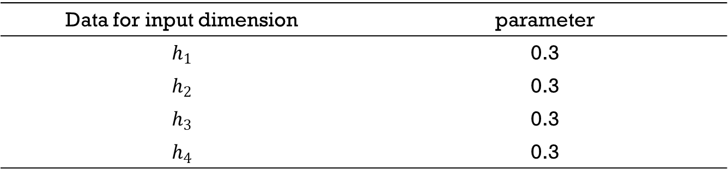
Model Construction: Structure Learning Parameter Setting of Subtractive clustering : subclust()
Data for input dimension | parameter
$$h_{1}$$ | 0.3
$$h_{2}$$ | 0.3
$$h_{3}$$ | 0.3
$$h_{4}$$ | 0.3

Slide 33






Model Construction: Structure Learning IF-Parts
Center
Gaussian
FUZZYSETs
STD
Subtractive clustering
$h_{1}$=$f_{65}$
3
Subtractive clustering
$h_{2}$=$f_{62}$
3
Subtractive clustering
$h_{3}$=$f_{2}$
3
Subtractive clustering
$h_{4}$=$f_{4}$
3
Number Of Cubes=3*3*3*3=81

Slide 34
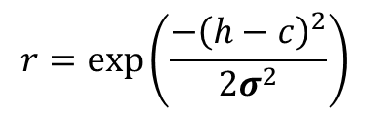
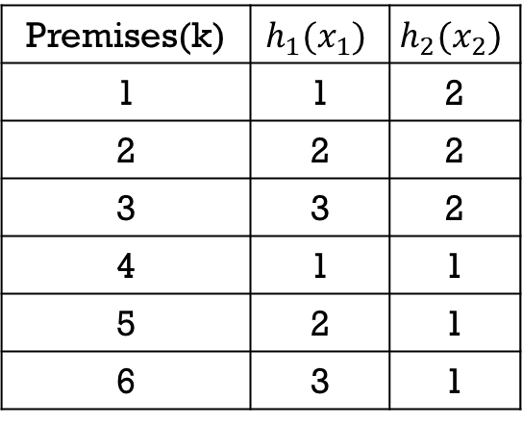



Model Construction: Structure Learning Selection of Premises
$$h_{2}(x_{2})$$
1
2
3
Premises(k) | $$h_{1}(x_{1})$$ | $$h_{2}(x_{2})$$
1 | 1 | 2
2 | 2 | 2
3 | 3 | 2
4 | 1 | 1
5 | 2 | 1
6 | 3 | 1
B2
4
5
6
B1
$$h_{1}(x_{1})$$
A1
A2
A3
Premise $k$ : IF $x_{1}=A^{(k)}$ and $x_{2}=B^{(k)}$
$$r=\exp\left(\frac{−{\left(h−c\right)}^{2}}{2σ^{2}}\right)$$
Notes:
h1孿生兄弟(x1)
h2攣生兄弟(x2)

Slide 35






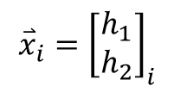



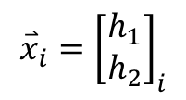
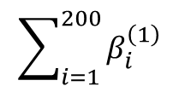
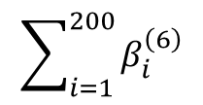

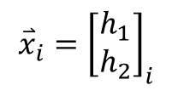


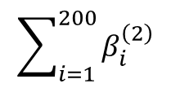

Model Construction: Structure Learning Selection of Premises
$$\overset{⃑}{h}=\left[\begin{matrix}x_{i,1} \\ x_{i,2}\end{matrix}\right]$$
$$β_{j}^{\left(k\right)}\left(\overset{⃑}{h}\right)=μ_{A^{\left(k\right)},j}\left(x_{i,1}\right)μ_{B^{\left(k\right)},j}\left(x_{i,2}\right),j=1,2,…,N$$
$$TD=\{\left({\overset{⃑}{x}}_{i},{\overset{⃑}{t}}_{i}\right),i=1,2,…,200\}$$
$$\sum_{i=1}^{200}{β_{i}^{\left(1\right)}}$$
$${\overset{⃑}{x}}_{i}={\left[\begin{matrix}h_{1} \\ h_{2}\end{matrix}\right]}_{i}$$
1
$${\overset{⃑}{β}}_{j}^{\left(1\right)}$$
$$β_{sum}^{\left(1\right)}$$
$$\sum_{i=1}^{200}{β_{i}^{\left(2\right)}}$$
$${\overset{⃑}{x}}_{i}={\left[\begin{matrix}h_{1} \\ h_{2}\end{matrix}\right]}_{i}$$
2
$${\overset{⃑}{β}}_{j}^{\left(2\right)}$$
$$β_{sum}^{\left(2\right)}$$
$$⋮$$
$$⋮$$
$$⋮$$
$$\sum_{i=1}^{200}{β_{i}^{\left(6\right)}}$$
$${\overset{⃑}{x}}_{i}={\left[\begin{matrix}h_{1} \\ h_{2}\end{matrix}\right]}_{i}$$
6
$${\overset{⃑}{β}}_{j}^{\left(6\right)}$$
$$β_{sum}^{\left(6\right)}$$
Threshold= ${mean(β}_{sum})+std(β_{sum})$

Slide 36


Model Construction: Structure Learning Selection of Premises
Threshold= ${mean(β}_{sum})+std(β_{sum})$
Number Of Cubes : 81
Number Of Cubes : 9
$β_{sum}^{\left(k\right)}$> Threshold

Slide 37
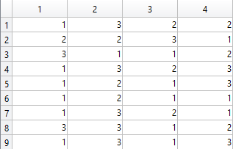
Model Construction: Structure Learning IF-Parts:Formation Matrix
Number Of Cubes : 9
Number Of Cubes : 9
透過上下界的篩選，可得到要訓練的Cubes
上界:15
下界:4

Slide 38



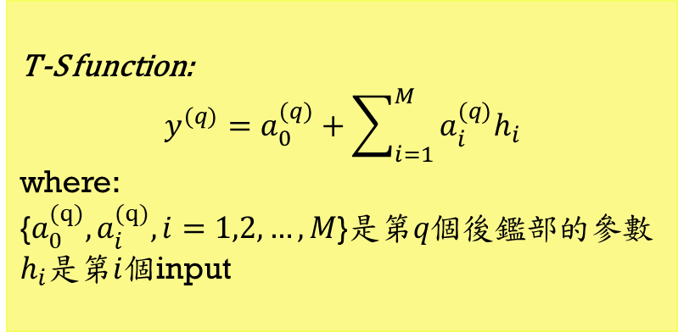


Model Construction: Structure Learning Consequences
subclust()
[$h_{1}$ $h_{2}$ ..$.{ h}_{M}$]
Number of aim objects(Q)
Center
FCM
STD
T-S function:
$$y^{(q)}=a_{0}^{(q)}+\sum_{i=1}^{M}{a_{i}^{(q)}h_{i}}$$
where:
{$a_{0}^{(q)},a_{i}^{(q)},i=1,2,…,M$}是第$q個$後鑑部的參數
$h_{i}$是第$i$個input
(q)
$${\overset{⃑}{λ}}^{(q)}$$
T-S function
$q^{th}$Aim Object
$q^{th}$ THEN-Part

Slide 39


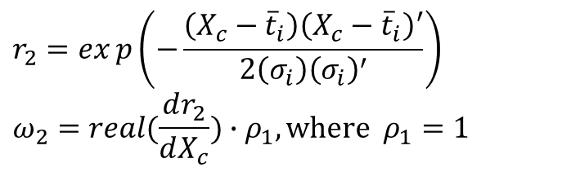


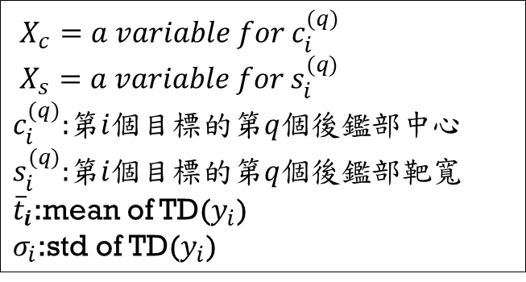
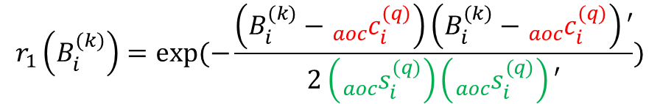

Model Construction: Structure Learning Aim Objects
$r_{1}\left(X_{c}\right)$的1次微分
$X_{c}=a variable for c_{i}^{(q)}$
$X_{s}=a variable for s_{i}^{(q)}$
$c_{i}^{(q)}$:第$i$個目標的第$q$個後鑑部中心
$s_{i}^{(q)}$:第$i$個目標的第$q$個後鑑部靶寬
${\overline{t}}_{i}$:mean of TD($y_{i}$)
$σ_{i}$:std of TD($y_{i}$)
$$λ_{i}^{(k→q)}=r_{1}\left(B_{i}^{(k)}\right)\exp\left(j∗ω\right)$$
$$r_{1}\left(B_{i}^{(k)}\right)=exp⁡(−\frac{\left(B_{i}^{(k)}−{{}_{aoc}^{}c}_{i}^{(q)}\right)\left(B_{i}^{(k)}−{{}_{aoc}^{}c}_{i}^{(q)}\right)′}{2\left({{}_{aoc}^{}s}_{i}^{(q)}\right)\left({{}_{aoc}^{}s}_{i}^{(q)}\right)′})$$
$${{}_{aoc}^{}c}_{i}^{(q)}=g_{2}=r_{2}exp\left(j∗ω_{2}\right)$$
$${{}_{aoc}^{}s}_{i}^{(q)}=g_{3}=r_{3}exp\left(j∗ω_{3}\right)$$
$$r_{2}=exp\left(−\frac{\left(X_{c}−{\overline{t}}_{i}\right){\left(X_{c}−{\overline{t}}_{i}\right)}^{′}}{2\left(σ_{i}\right){\left(σ_{i}\right)}^{′}}\right)$$
$$ω_{2}=real(\frac{dr_{2}}{dX_{c}})∙ρ_{1},where ρ_{1}=1$$
$$r_{3}=exp⁡(−\frac{\left(X_{s}\right)\left(X_{s}\right)′}{2(σ_{i})(σ_{i})′})$$
$$ω_{3}=real(\frac{dr_{2}}{dX_{s}})∙ρ_{2},where ρ_{2}=1$$
Notes:
${\overline{t}}_{i}$:mean of TD($y_{i}$)
$σ_{i}$:std of TD($y_{i}$)

Slide 40
MODEL CONSTRUCTION 1. Structure Learning 2. Model Structure and I/O Relationship 3. Parameter Learning

Slide 41
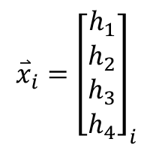



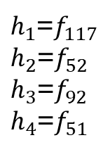


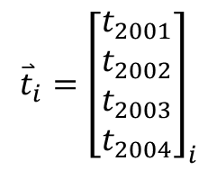
Model Construction: Model Structure and I/O Relationship Model
IF-Part
Aim
Object
THEN-Part
Model Output
Target
-
+
$${\overset{⃑}{t}}_{i}$$
$${\overset{⃑}{\hat{y}}}_{i}$$
+
$${\overset{⃑}{x}}_{i}$$
$${\overset{⃑}{e}}_{i}={\overset{⃑}{t}}_{i}−{\overset{⃑}{\hat{y}}}_{i}$$
$${\overset{⃑}{x}}_{i}={\left[\begin{matrix}h_{1} \\ h_{2} \\ h_{3} \\ h_{4}\end{matrix}\right]}_{i}$$
$h_{1}$=$f_{117}$
$h_{2}$=$f_{52}$
$h_{3}$=$f_{92}$
$h_{4}$=$f_{51}$
$${\overset{⃑}{t}}_{i}={\left[\begin{aligned}t_{2001} \\ t_{2002} \\ t_{2003} \\ t_{2004}\end{aligned}\right]}_{i}$$
$$TD=\{\left({\overset{⃑}{x}}_{i},{\overset{⃑}{t}}_{i}\right),i=1,2,…,219\}$$

Slide 42






























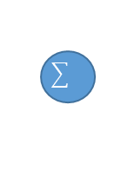









Model Construction: Model Structure and I/O Relationship Model
M: Number of Inputs K: Number of Premises
Q: Number of Consequence
N: Number of Outputs
$$\overset{⃑}{μ }$$
$${\overset{⃑}{β }}^{(1)}$$
$${\overset{⃑}{γ}}^{(1)}$$
$${\overset{⃑}{λ}}^{(1)}$$
$$A_{1}$$
$$1$$
$$1$$
$$1$$
$${\overset{⃑}{\hat{y}}}^{(1)}$$
$$h_{1}$$
$$A_{2}$$
$${\overset{⃑}{β }}^{(2)}$$
$${\overset{⃑}{γ}}^{(2)}$$
$${\overset{⃑}{λ}}^{(2)}$$
$$A_{3}$$
2
$$2$$
$$2$$
$${\overset{⃑}{\hat{y}}}^{(2)}$$
$$B_{1}$$
$$h_{2}$$
$$B_{2}$$
$$\overset{⃑}{\hat{y}}$$
$$B_{3}$$
$$⋮$$
$$⋮$$
$$⋮$$
$$⋮$$
$$⋮$$
$${\overset{⃑}{β }}^{(K)}$$
$${\overset{⃑}{γ}}^{(K)}$$
$${\overset{⃑}{λ}}^{(Q)}$$
$${\overset{⃑}{\hat{y}}}^{(Q)}$$
$$D_{1}$$
$$K$$
$$K$$
$$Q$$
$$h_{M}$$
$$D_{2}$$
$$D_{3}$$
Layer1
(Inputs)
Layer2
(Fuzzy-set)
Layer4
(Normalization)
Layer6
(Consequences)
Layer7
(Outputs)
Layer3
(Premises)
Layer5
(Aim Object)

Slide 43

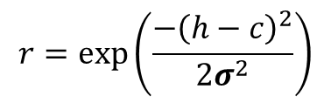
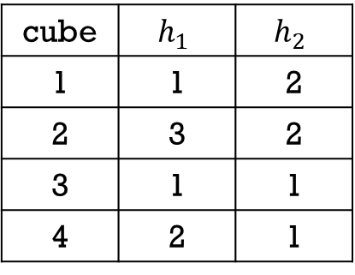
Model Construction: Model Structure and I/O Relationship IF-Parts(Example)
$$h_{2}(x_{2})$$
1
2
cube | $$h_{1}$$ | $$h_{2}$$
1 | 1 | 2
2 | 3 | 2
3 | 1 | 1
4 | 2 | 1
B2
Selected
Selected
3
4
B1
Selected
Selected
$$h_{1}(x_{1})$$
A1
A2
A3
Premises k : IF $x_{1}=A^{(k)}$ and $x_{2}=B^{(k)}$
$$r=\exp\left(\frac{−{\left(h−c\right)}^{2}}{2σ^{2}}\right)$$

Slide 44

Model Construction: Model Structure and I/O Relationship IF-part:Formation Matrix
Premise
selection

Slide 45











Model Construction: Model Structure and I/O Relationship Premises (IF-Parts)
$$\overset{⃑}{h}=\left[\begin{matrix}x_{i,1} \\ \begin{aligned}x_{i,2} \\ x_{i,3} \\ x_{i,4}\end{aligned}\end{matrix}\right]$$
$$β_{j}^{\left(k\right)}\left(\overset{⃑}{h}\right)=μ_{A^{\left(k\right)},j}\left(x_{i,1}\right)∙μ_{B^{\left(k\right)},j}\left(x_{i,2}\right)∙$$
$μ_{C^{\left(k\right)},j}\left(x_{i,3}\right)∙μ_{D^{\left(k\right)},j}\left(x_{i,4}\right),j=1,2,…,N$
$$TD=\{\left({\overset{⃑}{x}}_{i},{\overset{⃑}{t}}_{i}\right),i=1,2,…,200\}$$
$${\overset{⃑}{x}}_{i}={\left[\begin{matrix}h_{1} \\ \begin{aligned}h_{2} \\ h_{3} \\ h_{4}\end{aligned}\end{matrix}\right]}_{i}$$
IF-Part
1
$${\overset{⃑}{β}}_{j}^{\left(1\right)}$$
$${\overset{⃑}{x}}_{i}={\left[\begin{matrix}h_{1} \\ \begin{aligned}h_{2} \\ h_{3} \\ h_{4}\end{aligned}\end{matrix}\right]}_{i}$$
IF-Part
2
$${\overset{⃑}{β}}_{j}^{\left(2\right)}$$
$$⋮$$
$${\overset{⃑}{x}}_{i}={\left[\begin{matrix}h_{1} \\ \begin{aligned}h_{2} \\ h_{3} \\ h_{4}\end{aligned}\end{matrix}\right]}_{i}$$
IF-Part
$$K$$
$${\overset{⃑}{β}}_{j}^{\left(K\right)}$$
$K$=9

Slide 46



















Model Construction: Model Structure and I/O Relationship Sphere Complex Fuzzy Sets
$$X_{3}$$
$$u_{x_{1}}=r∙\cos\left(θ_{2}\right)∙\cos\left(θ_{1}\right)$$
$$u_{x_{2}}=r∙\cos\left(θ_{2}\right)∙\sin\left(θ_{1}\right)$$
$$u_{x_{3}}=r∙\sin\left(θ_{2}\right)$$
1
$$(u_{x_{1}},u_{x_{2}},u_{x_{3}})$$
$$r$$
where $r=\exp\left(\frac{−{\left(h−c\right)}^{2}}{2σ^{2}}\right)$ 、$θ_{1}=\frac{dr}{dx}∙λ_{1}$ 、$θ_{2}=\frac{d^{2}r}{dx^{2}}∙λ_{2}$
$$r\sin\left(θ_{2}\right)$$
保維法
$$μ_{1}=r∗exp(j(θ_{1}+θ_{2}))$$
$$θ_{2}$$
$$X_{2}$$
$$θ_{1}$$
$$r\cos\left(θ_{2}\right)$$
$$μ_{2}=u_{x_{1}}+u_{x_{2}}∙j$$
$$r\cos\left(θ_{2}\right)\sin\left(θ_{1}\right)$$
$$r\cos\left(θ_{2}\right)\cos\left(θ_{1}\right)$$
降維法
$$μ_{3}=u_{x_{2}}+u_{x_{3}}∙j$$
$$X_{1}$$
$$μ_{4}=u_{x_{3}}+u_{x_{1}}∙j$$
$$\overset{⃑}{μ}=\left[\begin{matrix}μ_{1} \\ \begin{aligned}μ_{2} \\ μ_{3} \\ μ_{4}\end{aligned}\end{matrix}\right]$$

Slide 47












Model Construction: Model Structure and I/O Relationship SCFSs
Membership
degrees
OUTPUT
TARGET
$$μ_{1}=r∗exp(j(θ_{1}+θ_{2}))$$
${\hat{y}}_{i}^{\left(1\right)}$
$$t_{i}^{(1)}=2001+2002∗j$$
$$μ_{2}=u_{x_{1}}+u_{x_{2}}∗j$$
${\hat{y}}_{i}^{\left(2\right)}$
$$t_{i}^{(2)}=2003+2004∗j$$
$$μ_{3}=u_{x_{2}}+u_{x_{3}}∗j$$
${\hat{y}}_{i}^{\left(3\right)}$
$$t_{i}^{(3)}=target5+target6∗j$$
$$μ_{4}=u_{x_{3}}+u_{x_{1}}∗j$$
${\hat{y}}_{i}^{\left(4\right)}$
$$t_{i}^{(4)}=target7+target8∗j$$

Slide 48









Model Construction: Model Structure and I/O Relationship Aim Objects
N層箭靶
(1)
$${\overset{⃑}{β}}^{(1)}={\left[\begin{matrix}β_{1} \\ β_{2} \\ ⋮ \\ β_{N}\end{matrix}\right]}^{(1)}$$
$${\overset{⃑}{λ}}^{(1)}$$
THEN-part
(2)
$${\overset{⃑}{β}}^{(2)}={\left[\begin{matrix}β_{1} \\ β_{2} \\ ⋮ \\ β_{N}\end{matrix}\right]}^{(2)}$$
$${\overset{⃑}{λ}}^{(2)}$$
THEN-part
$$⋮$$
$$⋮$$
$$⋮$$
$${\overset{⃑}{β}}^{(K)}={\left[\begin{matrix}β_{1} \\ β_{2} \\ ⋮ \\ β_{N}\end{matrix}\right]}^{(K)}$$
(Q)
$${\overset{⃑}{λ}}^{(Q)}$$
THEN-part

Slide 49










Model Construction: Model Structure and I/O Relationship Consequence
(THEN-parts)
$$B={\left[{\overset{⃑}{β}}^{\left(1\right)} {\overset{⃑}{β}}^{\left(2\right)}…{\overset{⃑}{β}}^{\left(K\right)}\right]}_{N×K}$$
$${{\overset{⃑}{\hat{y} }}^{(q)}}^{ }=φ^{(q)}×{\overset{⃑}{a}}^{(q)}$$
$${\overset{⃑}{β}}^{\left(k\right)}={\left[β_{1}^{\left(k\right)}β_{2}^{\left(k\right)} …β_{N}^{\left(k\right)}\right]}^{T}$$
$${\overset{⃑}{a}}^{(q)}={\left[a_{0}^{\left(q\right)} a_{1}^{\left(q\right)} …a_{M}^{\left(q\right)}\right]}_{(M+1)×1}^{T}$$
$B_{N}^{(k)}:第N個$目標中，第$k$個前鑑部的啟動強度
$a_{0}^{(q)}\sim a_{M}^{(q)}:第$q個後鑑部參數
$$L^{(q)}={\left[\begin{aligned}\begin{matrix}{{\overset{⃑}{λ}}^{\left(1→q\right)}}^{T} \\ {{\overset{⃑}{λ}}^{\left(2→q\right)}}^{T} \\ \begin{aligned}⋮ \\ {{\overset{⃑}{λ}}^{\left(K→q\right)}}^{T}\end{aligned}\end{matrix}\end{aligned}\right]}_{K×N}$$
$$H={\left[\begin{aligned}\begin{matrix}{\left({\overset{⃑}{h}}_{a}\right)}^{T} \\ {\left({\overset{⃑}{h}}_{a}\right)}^{T} \\ \begin{aligned}⋮ \\ {\left({\overset{⃑}{h}}_{a}\right)}^{T}\end{aligned}\end{matrix}\end{aligned}\right]}_{N×(M+1)}$$
$${\overset{⃑}{h}}_{a}={\left[1 (\overset{⃑}{h})\right]}^{T}$$
$$φ^{(q)}=B∙L∙H$$

Slide 50
MODEL CONSTRUCTION 1. Structure Learning 2. Model Structure and I/O Relationship 3. Parameter Learning

Slide 51






Model Construction: Parameter Learning Machine Learning
PSO
RLSE
Premises
(IF-Parts)
Consequences
(THEN-Parts)
-
+
$${\overset{⃑}{\hat{y}}}_{i}$$
+
$${\overset{⃑}{t}}_{i}$$
$${\overset{⃑}{x}}_{i}$$
Model Output
Target
$${\overset{⃑}{e}}_{i}={\overset{⃑}{t}}_{i}−{\overset{⃑}{\hat{y}}}_{i}$$
$${\overset{⃑}{x}}_{i}={\left[\begin{matrix}h_{1} \\ h_{2} \\ h_{3} \\ h_{4}\end{matrix}\right]}_{i}$$
$h_{1}$=$f_{65}$
$h_{2}$=$f_{62}$
$h_{3}$=$f_{2}$
$h_{4}$=$f_{4}$
$${\overset{⃑}{t}}_{i}={\left[\begin{aligned}t_{TAIEX} \\ t_{DJIA} \\ t_{NASDAQ} \\ t_{SP500}\end{aligned}\right]}_{i}$$
$$TD=\{\left({\overset{⃑}{x}}_{i},{\overset{⃑}{t}}_{i}\right),i=1,2,…,219\}$$

Slide 52




Model Construction: Parameter Learning Machine Learning(PSO)
$$\left.{\overset{⃑}{V}}_{i} (t+1)=ω{\overset{⃑}{V}}_{i}(t)+c_{1}ξ_{1}({\overset{⃑}{Pbest}}_{i}(t)−{\overset{⃑}{P}}_{i}(t))+c_{2}ξ_{2}(\overset{⃑}{Gbest} (t)−{\overset{⃑}{P}}_{i}(t)\right)$$
全群最佳位置
(Gbest)
新位置
自我最佳位置
(Pbest)
透過自我最佳位置
調整方向
$${\overset{⃑}{P}}_{i}\left(t+1\right)={\overset{⃑}{P}}_{i}\left(t\right)+{\overset{⃑}{V}}_{i}\left(t+1\right)$$
透過全群最佳位置
調整方向
${\overset{⃑}{P}}_{i}\left(t\right):$the position vector of particle $i$at iteration $t$.
${\overset{⃑}{V}}_{i}\left(t\right):$ the velocity vector of particle $i$at iteration $t$. ${\overset{⃑}{Pbest}}_{i}\left(t\right)$: the best position vector of particle $i$at iteration $t$.
$\overset{⃑}{Gbest}\left(t\right)$:the best position vector of all particle at iteration $t$.
$ω、C_{1}、C_{2}$:PSO parameters
$ξ_{1}$、$ξ_{2}$:random numbers in [0,1]
慣性方向
目前位置
第$i$顆粒子

Slide 53





Model Construction: Parameter Learning Cost Function
-
+
$${\overset{⃑}{\hat{y}}}_{i}$$
+
$${\overset{⃑}{t}}_{i}$$
Model Output
Target
$${\overset{⃑}{e}}_{i}={\overset{⃑}{t}}_{i}−{\overset{⃑}{\hat{y}}}_{i}$$
$$RMSE=\sqrt{\frac{\sum_{i=1}^{n}{\left({\overset{⃑}{e}}_{i}\right)\left({\overset{⃑}{e}}_{i}\right)′}}{n}}$$
$n$=219

Slide 54



Model Construction: Parameter Learning Flowchart of the PSO-RLSE method
Initialize swarm
Start Iteration
Construct Fuzzy set
Prepare A、y
Calculate Firing-Strength
Initialize$P_{0}、 {\overset{⃑}{\text{θ}}}_{0}$
Calculate RMSE
Calculate Aim Of Object
Update$P_{k+1}$
Update Gbest、Pbest
Recursively
Update ${\overset{⃑}{\text{θ}}}_{k+1}$
Update Velocity
Calculate Output
Update Position
Get Consequences parameters
No
STOP?
Yes
End

Slide 55

Model Construction: Parameter Learning Model Setting
Parameter | Value
Number of inputs | {$f_{65} f_{62} f_{2} f_{24}$ }
Number of targets (real-valued) | 4
Number of outputs (complex-valued) | 2
Type of premises | Sphere complex fuzzy set
Number of premises (after selection) | 9
Number of premise parameters | 48
Number of aim object | 4
Type of consequences | Takagi-sugeno
Number of consequences | 4
Number of consequence parameters | 20
Notes:
Number of Premise parameters : 4(INPUT)*3(每一個INPUT剛好都分3群)*4(Center、Std、lambda1、lambda2)=48
Number of Consequence parameters : 5*(1+4)=25

Slide 56

MODEL CONSTRUCTION: Parameter Learning
PSO parameters
Parameters | value
Swarm size | 64
Iterations | 100
$ω c_{1} 、c_{2}$ | 0.8 2.0 2.0
$ξ_{1}、ξ_{2}$ | Random in [0,1]
Velocity | 0
RLSE parameters
Parameters | value
$α$ | ${1×10}^{8}$
${\overset{⃑}{\text{θ}}}_{0}$ | 20x1 zero vector
$P_{0}$ | $α$I
I | 20x20 identify matrix

Slide 57

Premises Parameters (after learning)
Table Parameters of Premises
Input | Fuzzy sets
$$h_{1}$$ | A1 |  |  |  |  | A2 |  |  |  |  | A3
 | c | $$σ$$ | $$λ_{1}$$ | $$λ_{2}$$ |  | c | $$σ$$ | $$λ_{1}$$ | $$λ_{2}$$ |  | c | $$σ$$ | $$λ_{1}$$ | $$λ_{2}$$
 | -128.35 | 71.79 | -39.87 | 5.47 |  | -24.17 | 45.52 | 13.26 | -52.75 |  | 121.20 | 96.42 | 3.41 | 12.37
$$h_{2}$$ | B1 |  |  |  |  | B2 |  |  |  |  | B3
 | C | $$σ$$ | $$λ_{1}$$ | $$λ_{2}$$ |  | c | $$σ$$ | $$λ_{1}$$ | $$λ_{2}$$ |  | c | $$σ$$ | $$λ_{1}$$ | $$λ_{2}$$
 | -309.40 | 156.58 | -16.27 | 31.47 |  | -88.22 | 130.49 | -12.86 | 16.66 |  | 202.96 | 163.52 | -24.65 | 19.95
$$h_{3}$$ | C1 |  |  |  |  | C2 |  |  |  |  | C3
 | c | $$σ$$ | $$λ_{1}$$ | $$λ_{2}$$ |  | c | $$σ$$ | $$λ_{1}$$ | $$λ_{2}$$ |  | c | $$σ$$ | $$λ_{1}$$ | $$λ_{2}$$
 | -50.03 | 82.52 | -17.60 | -10.88 |  | 43.68 | 59.62 | -15.20 | 12.69 |  | 104.00 | 89.75 | -12.00 | -10.91
$$h_{4}$$ | D1 |  |  |  |  | D2 |  |  |  |  | D3
 | c | $$σ$$ | $$λ_{1}$$ | $$λ_{2}$$ |  | c | $$σ$$ | $$λ_{1}$$ | $$λ_{2}$$ |  | c | $$σ$$ | $$λ_{1}$$ | $$λ_{2}$$
 | -188.10 | 65.08 | 2.68 | 14.86 |  | -25.48 | 117.38 | -6.35 | 7.36 |  | 122.86 | 160.51 | -4.72 | -5.60

Slide 58


Aim Object Parameters
Layer1 of Aim Object
 | Center | Spread | $${}_{aoc}^{}c$$ | $${}_{aoc}^{}s$$ | $$ρ_{1}$$ | $$ρ_{2}$$
Aim object1 | -3.76-129.01i | 142.08+141.88i | 0.8306-0.0000i | 0.6065-0.0013i | 1 | 1
Aim object2 | 138.48-19.33i | 142.08+141.88i | 0.7709-0.0021i | 0.6065-0.0013i | 1 | 1
Aim object3 | -16.37+113.16i | 142.08+141.88i | 0.8357+0.0002i | 0.6065-0.0013i | 1 | 1
Aim object4 | -15.98+6.32i | 142.08+141.88i | 0.7435+0.0021i | 0.6065-0.0013i | 1 | 1
Layer2 of Aim Object
 | Center | Spread | $${}_{aoc}^{}c$$ | $${}_{aoc}^{}s$$ | $$ρ_{1}$$ | $$ρ_{2}$$
Aim object1 | -139.36+31.05i | 141.21+141.70i | 0.7869+0.0021i | 0.6065-0.0013i | 1 | 1
Aim object2 | 132.35-31.03i | 141.21+141.70i | 0.7817-0.0021i | 0.6065-0.0013i | 1 | 1
Aim object3 | 4.21+116.96i | 141.21+141.70i | 0.8306-0.0002i | 0.6065-0.0013i | 1 | 1
Aim object4 | 23.17-136.08i | 141.21+141.70i | 0.8025+0.0003i | 0.6065-0.0013i | 1 | 1
Notes:
Radius:
0.0626
0.9724
0.6032
0.9479
0.3660

Slide 59


Consequences Parameters
$$\text{θ}=$$

Slide 60


Slide 61


Slide 62


Slide 63


Slide 64


Slide 65
Performance(RMSE)
 | Performance (RMSE)
triers | Normalized
1 | 279.40
2 | 279.35
3 | 279.59
4 | 280.96
5 | 279.61
6 | 280.91
7 | 280.50
8 | 280.10
9 | 280.76
10 | 282.01

Slide 66
T-S
1
2
…
4

